Slide 1
VOLUNTEER
Show us your character

Slide 2
The American Volunteer

Slide 3
About the volunteer
Civic engagement and volunteer service strengthens the fabric of our Nation and reflects the true heart, spirit, and goodness of America.
Our national character is measured by the unity, compassion, and initiative shown by Americans who help others.
~National Volunteer Week, Presidential Proclamation 10012

Slide 4
Revolutionary War
1776
First major volunteer recruitment effort
Everyday civilians banded together
Raising funds, Boycotting British goods
Throughout the country, volunteerism expanded beyond faith and the church and into patriotism. Volunteering was a way for ordinary people to demonstrate love for their country and support war efforts.
Faith • Patriotism

Slide 5
Volunteer
Connect
To your community
With people who share your passions
To solve a problem
Solve
Problems that break your heart
A need where your skillset makes a difference
With a small gesture of your time and talent
Connect • Solve
Notes:
Who are you and what’s your passion? Volunteering is personal.

Slide 6
First Firehouse All volunteer • Philadelphia
Early accounts of volunteerism in America started along with the urban centers that developed in the colonies. The first volunteer firehouse was started in Philadelphia by Benjamin Franklin in 1736. During this time, volunteerism was rooted in bettering the community and faith-based charity work.
Notes:
These volunteer firefighters didn’t feel entitled to be compensated for their time. They stepped up to address a most important need, a need that would save lives. They still held down their jobs and took care of business, and when a fire broke out, they stepped up to serve.

Slide 7
1800’s
Phlanthropic Causes
YMCA
The Red Cross
The Salvation Army
United Way
“The settlement house,” the foundation for today’s social work
As the country continued to industrialize, these groups kicked off the spirit of reform that would continue to define American volunteerism.
Public Awareness • Social Reform
Notes:
Faith-based missions remained strong while volunteers leveraged their roots in other areas such as recreation through the YMCA, disaster relief through the Red Cross.

Slide 8
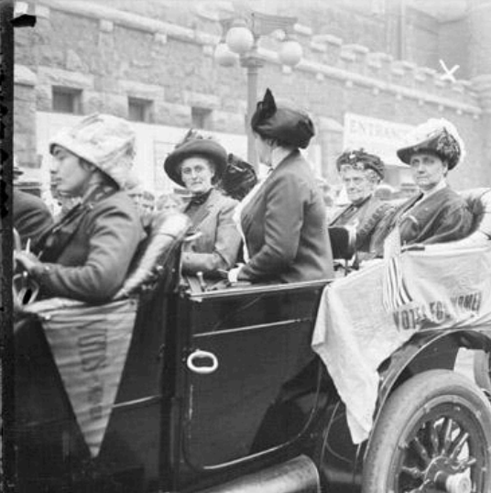
Jane Addams Hull House • Social Work Pioneer
European emigration spurred the growth of settlement houses. American citizens–like Jane Addams–organized outreach and support for families and children, advocating for schools, healthcare, child labor laws, safe living conditions and parks.
YOU can, too!
Notes:
In the late 1800’s, with the influx of emigration from Europe & the industrial revolution there came to be the growth of urban apartments; “settlement houses” (today, known as a getto). Under the leadership of Jane Addams, at Hull House in Chicago, volunteers from churches were organized to do outreach & support for poor families & their children. The movement spread across the east coast; with volunteers advocating & addressing the lack of schools, health care, unsanitary living conditions and child labor (laws.). As well, parks and recreational activities (YMCA) were created. The “settlement house movement” was the foundation of social work as we know it today.

Slide 9
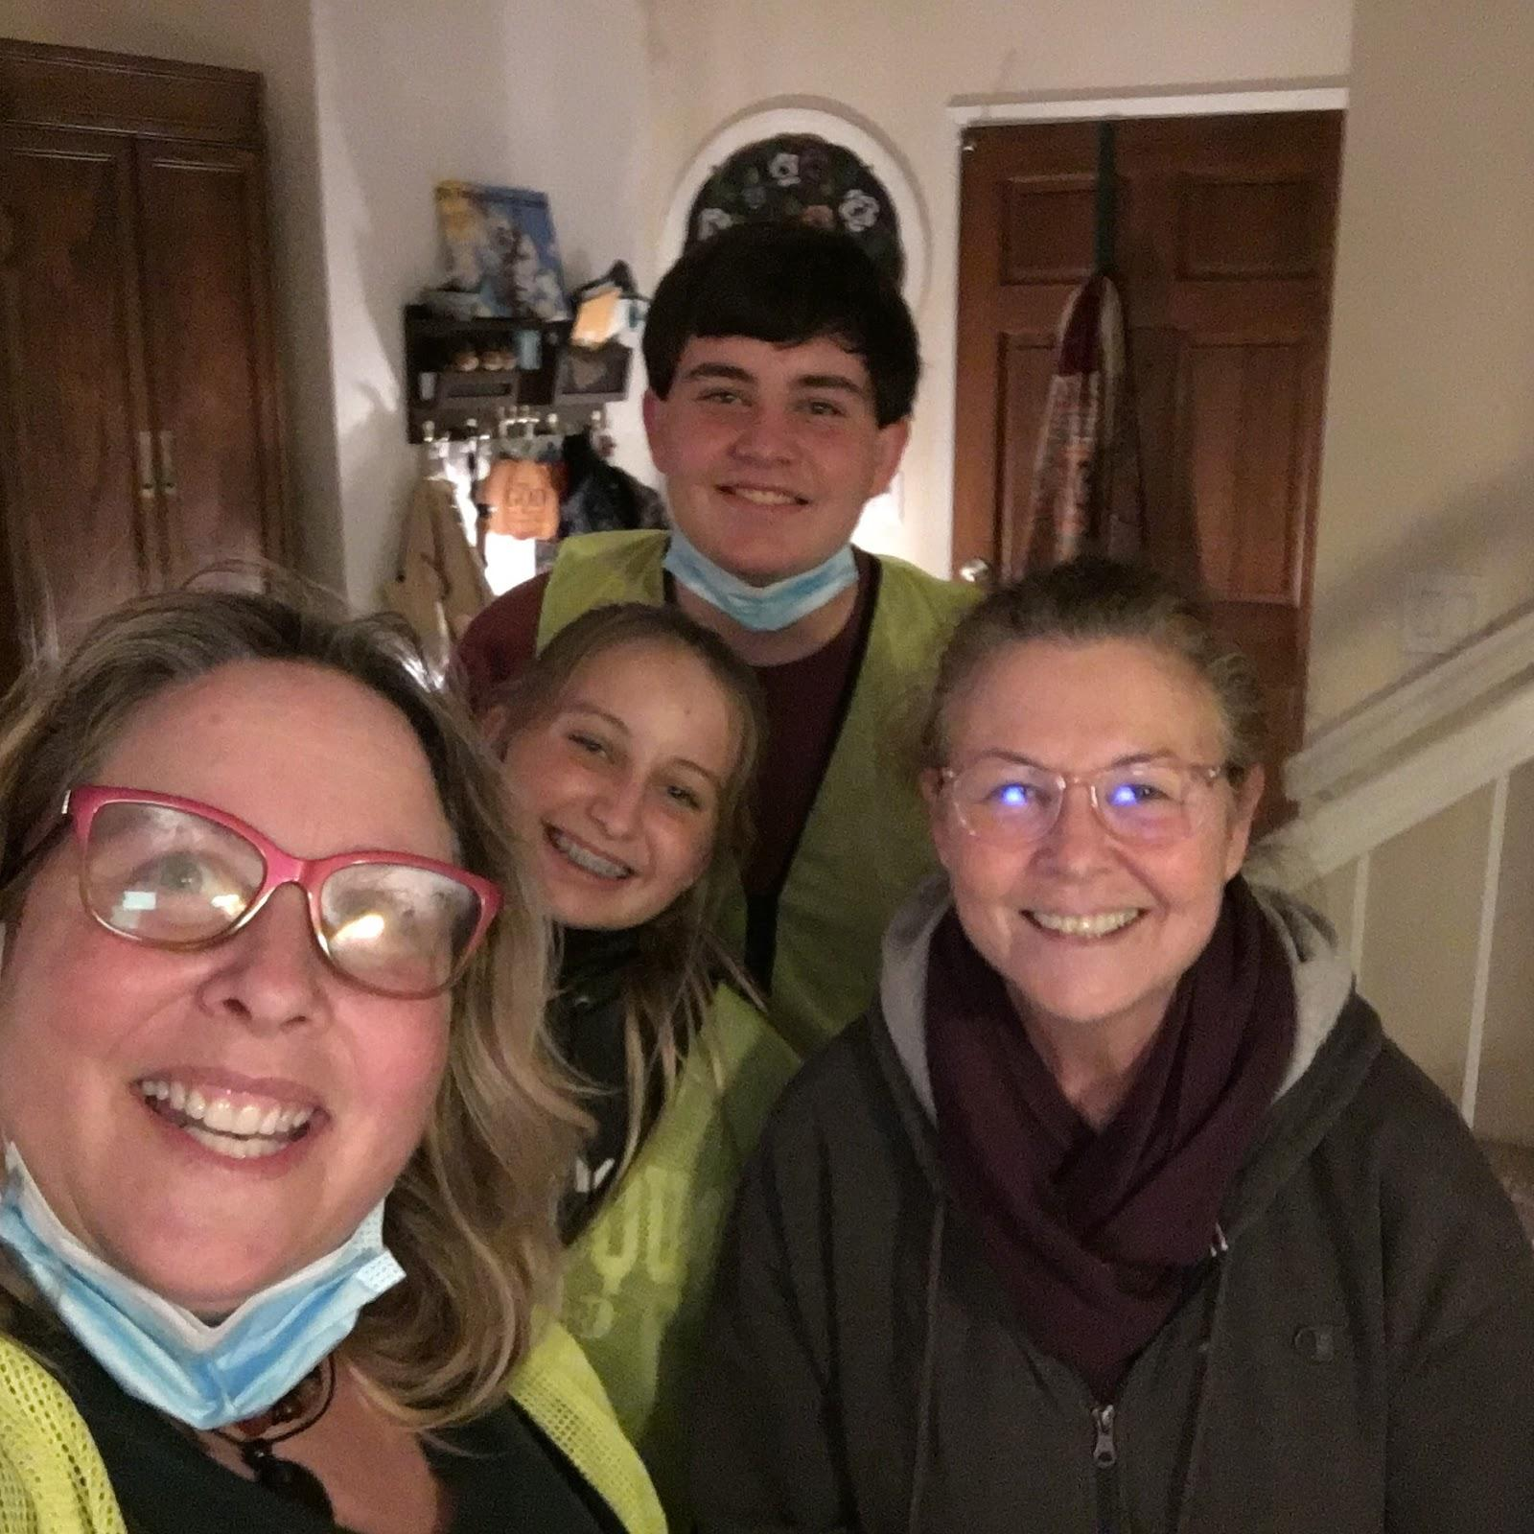
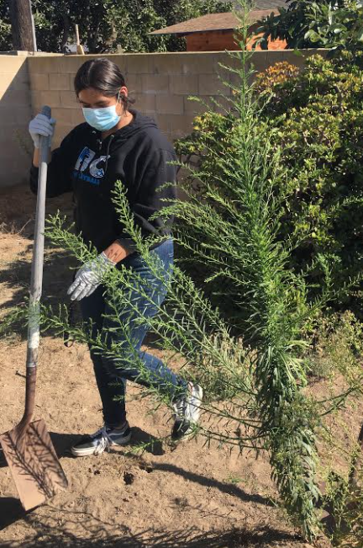
Notes:
Here are some real volunteers! Paying friendly visits, walking miniature horses and doing yardwork at the home of an elderly woman who no longer has the strength to use a shovel.

Slide 10
One-on-One Senior/Volunteer Match
Qualifiers
Activity
In your neighborhood
Skillset
Personal Interests
3 hours per week
With or without a car
Be matched with a senior who lives close by to provide neighborly deeds like companionship, transportation to medical appointments, grocery shopping, simple household chores, outings such as coffee, going on a walk or picking up prescriptions.
This could also be an Adopt-a-Grandparent match where the volunteer takes their grade school children along. Typically 2-4 hours per week, based on the volunteer’s availability.

Slide 11
Transportation
Qualifiers
Activity
Within driving distance
Flexible time/day
Your car & gas
Up to 2 hours per week
Bring a book!
Volunteers use their personal vehicle to provide door through door transportation service for seniors’ medical appointments. The volunteer provides transportation to and from the senior’s medical appointment. The volunteer logs into our CareWorks Network platform to view and retrieve requests for transportation when they are available.
The volunteer calls the senior to confirm the ride. This is typically done during the day once or twice a month and generally takes less than two hours per round trip

Slide 12
Phone Friends
Qualifiers
Activity
Likes to talk on the phone
Flexible time/day
Uses your phone
Starts at 30 minutes
Take a few notes
Once a month, volunteers call homebound seniors to check in on their wellbeing or to foster a peer-to-peer friendship. Volunteers choose the number of seniors they wish to call. Calls are made at the convenience of the volunteer and average ten minutes for a quick call or thirty minutes to foster a friendship.
To maintain privacy, explore using a phone app that masks the call as if coming from your local volunteer caregiving office.

Slide 13
1900’s
Mainstream Volunteerism
Rotary Club (1905)
Kiwanis International (1915)
Lions International (1917)
The Peace Corps (1961)
Graduation requirements
Corporations grew and corporate philanthropy became a large part of the volunteer landscape.
General Electric created the first matching gift program in 1954, and today companies of all sizes offer volunteering programs and volunteer grants to their employees.
Business • Community
Notes:
Volunteerism evolved under a new umbrella of business networking, not unlike what happened with the Puritans who channeled their successes from Capitalism into social services. The government then saw an opportunity and created The Peace Corps, adding a compensation component that allowed people to dedicate a greater portion of their lives to meaningful work they would not otherwise be able to do. We have to ask ourselves, “Do we dilute or enhance the impact of volunteerism when we add a price tag or motivate young people through graduation perks?”

Slide 14
Volunteer Caregiving 1984
Neighbors Helping Neighbors
Launched as Faith in Action, the Robert Wood Johnson Foundation invested $100 million to establish 1,000 programs throughout every state in the union, plus the territories of Guam, Puerto Rico and the Virgin Islands. It’s estimated that Volunteer Caregiving serves more than 500,000 seniors and people with disabilities thanks to a volunteer force of more than 350,000.
Engage diverse communities • Recruit, Train, Coordinate • Provide non-professional services • Serve aging, disabled • Provide care where people reside
Notes:
Forward thinking model that anticipated the growing number of aging Americans and the need to have a coordinated approach to keeping the neighborhood intact. Volunteer Caregiving movement recognized that the next generation would be flying the coop across the country where they would leave their parents to age in place, alone. This model has literally introduced neighbors who lived across the street from each other and now lend a helping hand thanks to their local volunteer caregiving program.

Slide 15
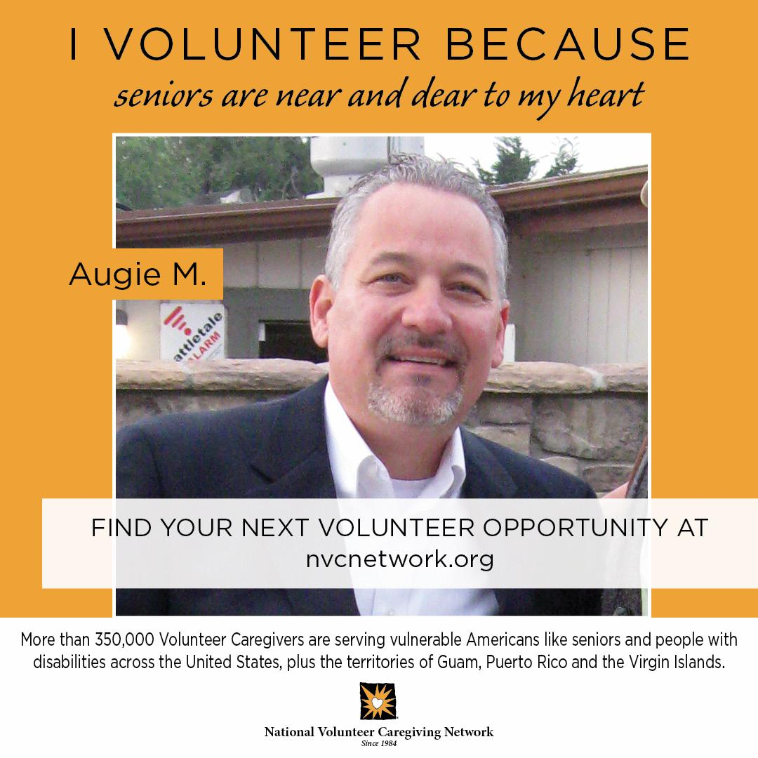
Augie M. One hour per week • Director
Currently, Augie serves on a local board of directors and works professionally in banking. He monitors financials and uses his institutional knowledge for strategic planning.
Notes:
Here’s a real volunteer! There are lots of ways to volunteer.
From Doretta Herr, Illinois:
I would also highlight a few things when speaking to millenials.
First, this group wants short term projects.
Therefore, I highlight short term commitments and flexibility.
I tell them they are free to leave town for six months if necessary. This is an opportunity that allows you to watch the grandkids for spring break.
I tell them they can be part of a planning committee charged with decorating for our annual luncheon and other socials. They love this short term commitment.
We don't outsource the assembly and folding of the quarterly newsletter because this gives volunteers an opportunity to socialize in our office. They want to have fun.
Needless to say, the office staff AND volunteers use this opportunity to recruit help in the office for mailings.
We have identified some that have grant writing skills, marketing or public relation skills, that help us in many ways just with this extra conversation.
When we have good luck in forming a relationship, they donate more too.
The presentation needs to come off as an exciting opportunity to be a part of a group that is making a difference.

Slide 16
Shop & Drop
Qualifiers
Activity
In your neighborhood
Flexible time/day
Shop where you already go, or discover something new
Quick errands start at 45 minutes
Contactless delivery available
Shop for and deliver groceries or prescriptions to homebound seniors. The volunteer logs into our CareWorks network to view and retrieve requests. Volunteers can work around their schedule to make deliveries at their convenience. Volunteers shop on average twice per month.
Consider shopping for your groceries at the same time and save a trip!

Slide 17
Building Bridges Intergenerational Program
Qualifiers
Activity
In your neighborhood
Two hours per assignment
2-4 times per month
Mentor college-bound students
Connect with more than one senior in need
Adult volunteers are assigned to be Team Leaders to college bound upperclassmen high school students who provide approximately one hour of light housekeeping and yard work to frail seniors.
The Team Leaders drive the students to the senior’s house, oversee and assist the students
while also engaging with the senior during the visit.
Office staff coordinate with the senior, the Team Leader and the students on a schedule to suit everyone’s availability. Allow two hours for each assignment. After training is complete, adults and students volunteer 2-4 times per month.

Slide 18
Honey Do Crew
Qualifiers
Activity
In your neighborhood
Time varies by project
2-3 times per month, as needed
Uses your skillset
Connect with more than one senior in need
Volunteers do minor repairs and tasks such as plumbing, electrical, and household maintenance. Staff calls the volunteer to inquire about availability as requests come in.
The senior is responsible for providing or paying for parts while the volunteer supplies the labor.
Requests include hanging curtain rods, fixing a leaky faucet, changing the filter on an a/c unit, hanging mirrors or pictures on the wall.
Occasional requests for larger projects such as water heaters, toilets and minor roof repair present opportunities to partner with other volunteer organizations.

Slide 19
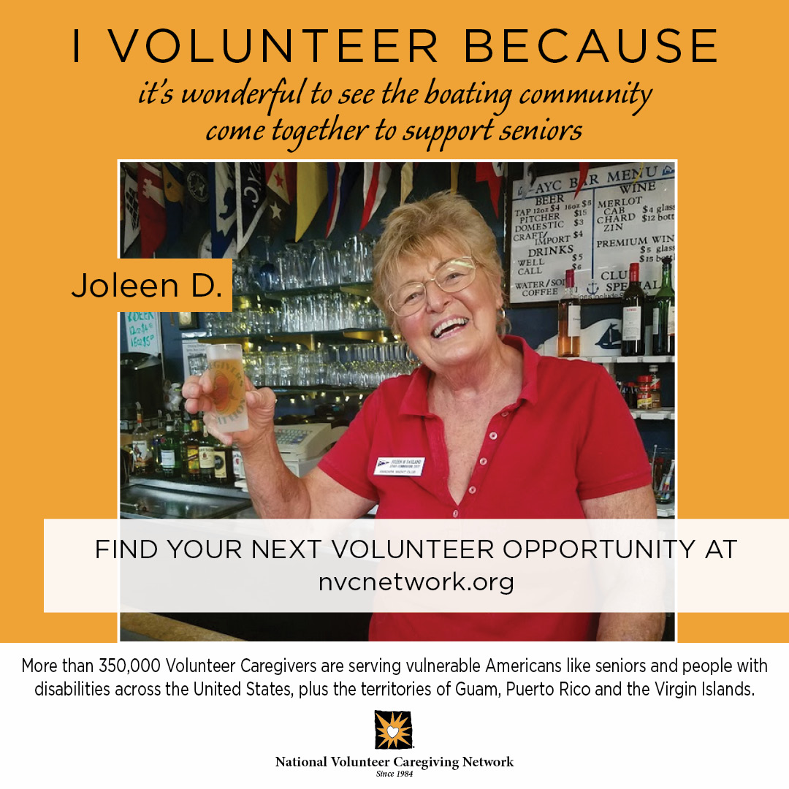
Joleen D. Five hours per year • Bartending
A member of a local yacht club, Joleen makes a point to volunteer every year as the bartender at the annual sailing fundraiser. She donates her tips to buoy up the final tally.
Notes:
Here’s a real volunteer!

Slide 20
Hospital to Home
Qualifiers
Activity
In your neighborhood
Minimum of 45 minutes per week
Mini-Match for up to one month
Once a year or more depending on your availability
No medical or professional care
Volunteers provide support and monitor high-risk seniors for up to 30 days when released from hospitals, emergency rooms, and urgent care facilities so that they may successfully recover at home.
The volunteer calls 4-7 times per week to check in, may provide or work with the Office Team to provide light housekeeping, transportation to medical
appointments, pet support, or other needs such as grocery shopping, meal prep or pick up prescriptions.

Slide 21
Dementia Friendly Relief
Qualifiers
Activity
In your neighborhood
Approx. 3 hours per week
Transportation is discouraged
Service for early stages of Alzheimer’s
No medical or professional care
Respite care is provided for family caregivers caring for a loved one in the early stages of dementia and Alzheimer’s.
Time commitment is determined by the volunteer and the needs of the family caregiver. There is a 10-hour training requirement prior to assignment.
Additional opportunities available to advance your knowledge of dementia and. Alzheimer’s

Slide 22
Volunteer Liaison
Qualifiers
Activity
Likes to talk on the phone
Flexible time/day
Uses your phone
Starts at 30 minutes
Take a few notes
This remote opportunity helps the office team stay in touch with the broader volunteer base. Volunteers choose the number of volunteers they wish to call quarterly, every other month.
Calls average ten minutes. To maintain privacy, explore using a phone app to mask the call as if coming from your local volunteer caregiving office.
This is an ideal assignment for a volunteer who has previously served and wants to scale back, or a volunteer who wants to gain insight into various opportunities.

Slide 23
Meal Prep
Qualifiers
Activity
Likes to cook
Flexible time/day
Uses your phone
Starts at four hours
Make it a Match, or limit the time through Hospital to Home
Be an integral part of the Hospital to Home program by working with the Office Team and other volunteers to provide support for high-risk seniors for up to 30 days when released from hospitals, emergency rooms, and urgent care facilities so that they may successfully recover at home.
Meal prep is one of the biggest challenges seniors face when they
Are recovering from a hospital stay.
Learn how to prep and stock up on meals that the senior can use during their recovery.
You supply the labor. The senior covers the cost of groceries.

Slide 24
2000’s
Blurring the lines
Federal & International Priorities
Economic Decline
Community Organizers
WIFM
At the turn of the century, this mix of community-based, faith-based, corporate, and political forces kept Americans engaged with volunteerism in an extremely wide range of ways.
Time • Treasure
Notes:
Volunteer experiences vary throughout our community. Volunteer Caregiving honors the original spirit of giving from the heart. Our volunteers are fully vetted, trained with informed consent and compensated with a smile. We don’t believe in politicizing your participation. Volunteer Caregivers give their time to help a neighbor–because it’s a value that not only defines us personally, it defines us nationally.

Slide 25
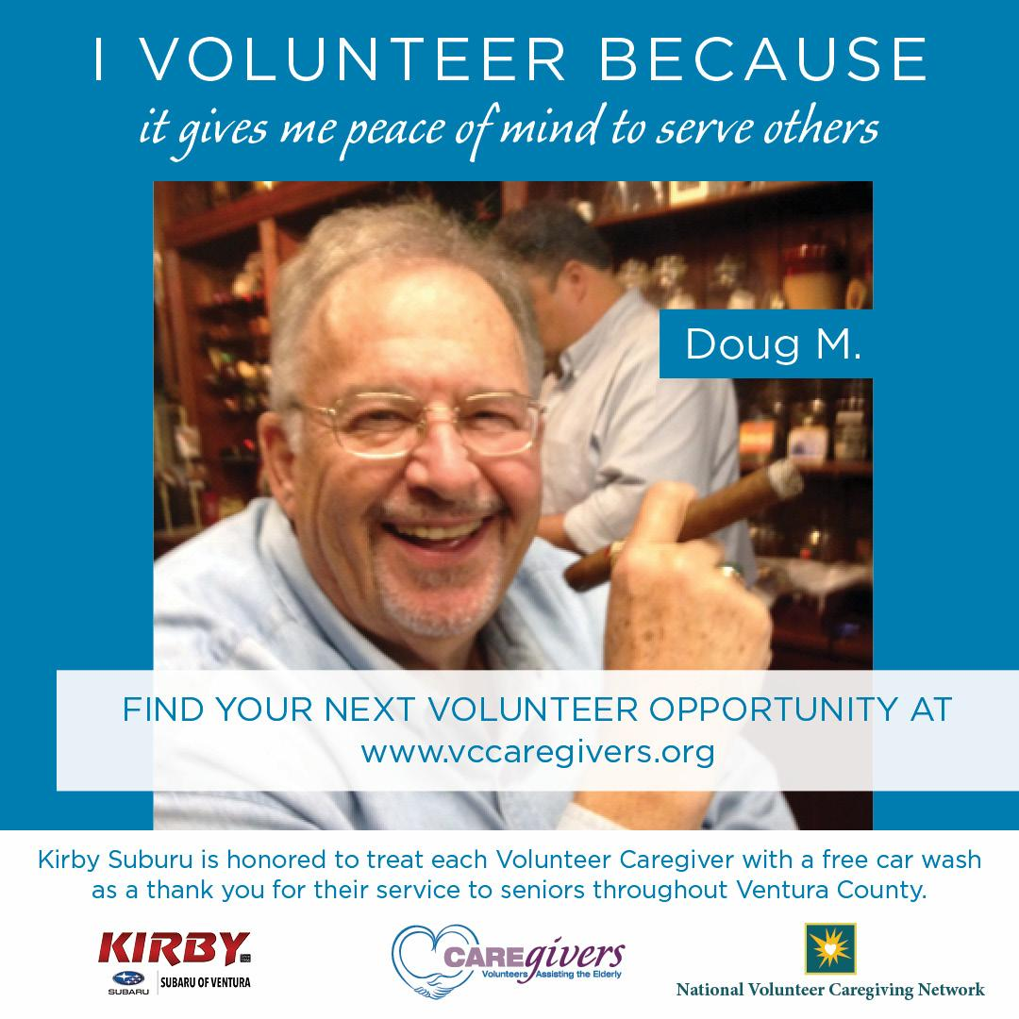
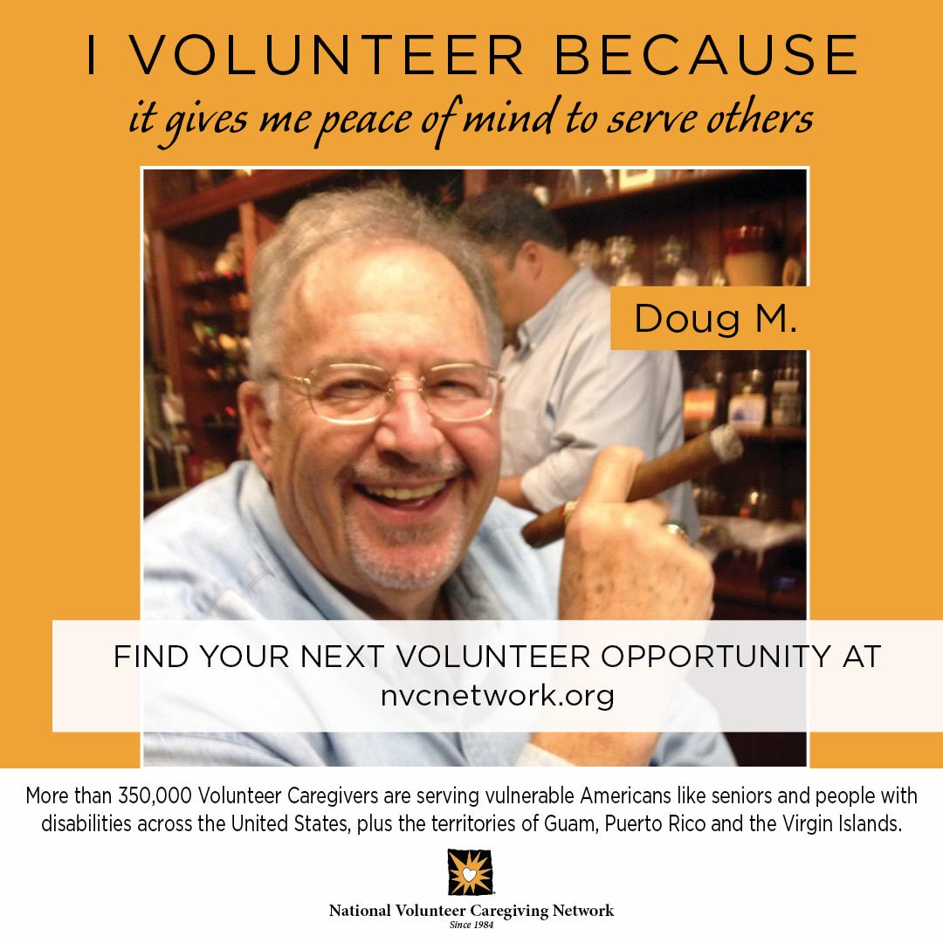
Doug M. Six hours per week • Serves 550
Now retired, Doug uses his professional experience in social work to help refine best practices in serving seniors as a Field Supervisor for graduate students pursuing the field.
Notes:
Here’s a real volunteer!

Slide 26
Volunteer?
Time & Treasure
Speaks to your heart
Uses your personal assets
Changes your world
Legacy
From your rocking chair
What did you give
What did you get
Government • Faith-Based
Corporate • Social Reformation
Secular • Humanist
Notes:
We hope you’ll find a meaningful way to share your time and treasure in the community. Consider your interests, your skillset and the impact you would like to make.

Slide 27
Volunteer
Get Started
Pre-screened with an application
Interview with reference check
Free background check
Train & Serve
Training is provided to guide the volunteer experience.
Work with Volunteer Caregiving to find the right assignment.
Please contact us at any time if you would like to change your assignment
Get Started • Train & Serve
Notes:
Frankly, we’d like you to join the Volunteer Caregiving movement. We highlighted examples of how you might volunteer, but these aren’t the only assignments. We also need photographers, speakers, help picking up auction items for our next event as examples.

Slide 28
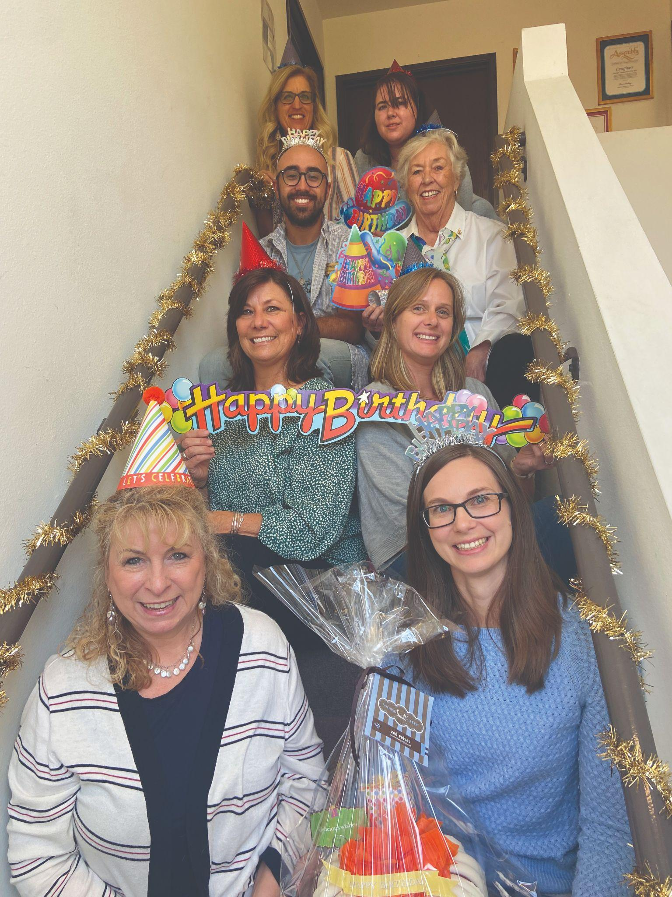
Contact
Max Castro
connect@vccaregivers.org
For more information, visit www.vccaregivers.org
Notes:
Our local program is here to serve the community. Please let us know if you would like to volunteer, donate or refer a client for services.

